Slide 1
Ant System: Optimization by a Colony of Cooperating Agents
Authors: Dorigo, M., Maniezzo, V., Colorni, A.
Presenter: Wong, J.
CAP 6675 Presentation

Slide 2
Motivation
Inspiration from path-finding ants
Inspiration from “natural” optimization algorithms
Components:
Positive feedback (pheromone or “trail”)
Distributed computation (m ant agents)
Constructive greedy heuristic (visibility)
Notes:
Natural algorithms: ex NNs, Gas, evolution, immune networks, simulated annealing

Slide 3
Goal
Describe Ant System (AS), an optimization algorithm
Differentiate AS from other heuristics
Demonstrate AS versatility + robustness
Discuss AS intuition

Slide 4
Method – Ant System
1
2
3
4
Adapted from (Dorigo, M., et. al., 1996)
Notes:
Describe 2x2 figure adapted from (Dorigo, M., et. al., 1996). Black edges are length 1. Red edges are length 2. This is my running example
Define Traveling Salesman Problem: find a tour of n nodes with a minimum cumulative edge distance

Slide 5
Method – Ant System
1
2
Sight, Memory, Discrete Time
1) Chooses next town according to trail + distance
2) Cannot revisit towns
3) Lays trail after completing tour
3
4
Adapted from (Dorigo, M., et. al., 1996)
Notes:
Describe artificial ant characteristics: (can see, remembers things, time is discrete). Describe constraints 1-3.
Iteration is one ant move. All iterations for all m ants is a cycle. There are NC_max cycles total.

Slide 6
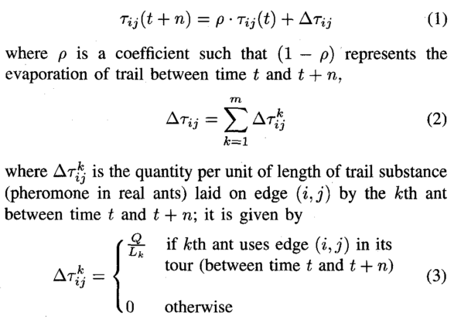
Method – Ant System
1
2
3
4
Adapted from (Dorigo, M., et. al., 1996)
(Dorigo, M., et. al., 1996)
Notes:
Describe trail equations. Rho is evaporation hyper parameter (how much of old trail remains). Tau is trail intensity.
After a tour, trail intensity for one edge for one cycle is fraction of old trail plus new trail added by any ants that used this trail.
Trail contribution from one ant is inversely proportional to its tour length.

Slide 7
Method – Ant System
1
2
3
4
Adapted from (Dorigo, M., et. al., 1996)
(Dorigo, M., et. al., 1996)
Notes:
Describe trail equations. Rho is evaporation hyper parameter (how much of old trail remains). Tau is trail intensity.
After a tour, trail intensity for one edge for one cycle is fraction of old trail plus new trail added by any ants that used this trail.
Trail contribution from one ant is inversely proportional to its tour length.

Slide 8
Method – Ant System
1
2
3
4
Adapted from (Dorigo, M., et. al., 1996)
(Dorigo, M., et. al., 1996)
Notes:
Describe trail equations. Rho is evaporation hyper parameter (how much of old trail remains). Tau is trail intensity.
After a tour, trail intensity for one edge for one cycle is fraction of old trail plus new trail added by any ants that used this trail.
Trail contribution from one ant is inversely proportional to its tour length.

Slide 9
Method – Ant System
1
2
3
4
Adapted from (Dorigo, M., et. al., 1996)
(Dorigo, M., et. al., 1996)
Notes:
Describe trail equations. Rho is evaporation hyper parameter (how much of old trail remains). Tau is trail intensity.
After a tour, trail intensity for one edge for one cycle is fraction of old trail plus new trail added by any ants that used this trail.
Trail contribution from one ant is inversely proportional to its tour length.

Slide 10
Method – Ant System
1
2
3
4
Adapted from (Dorigo, M., et. al., 1996)
(Dorigo, M., et. al., 1996)
Notes:
Describe trail equations. Rho is evaporation hyper parameter (how much of old trail remains). Tau is trail intensity.
After a tour, trail intensity for one edge for one cycle is fraction of old trail plus new trail added by any ants that used this trail.
Trail contribution from one ant is inversely proportional to its tour length.

Slide 11
Method – Ant System
1
2
3
4
Adapted from (Dorigo, M., et. al., 1996)
(Dorigo, M., et. al., 1996)
Notes:
Describe trail equations. Rho is evaporation hyper parameter (how much of old trail remains). Tau is trail intensity.
After a tour, trail intensity for one edge for one cycle is fraction of old trail plus new trail added by any ants that used this trail.
Trail contribution from one ant is inversely proportional to its tour length.

Slide 12
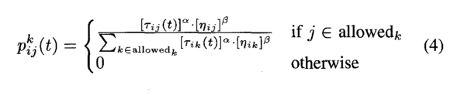
Method – Ant System
1
2
(Dorigo, M., et. al., 1996)
3
4
Adapted from (Dorigo, M., et. al., 1996)
Notes:
Describe probability function

Slide 13
Method – Ant System
1
2
(Dorigo, M., et. al., 1996)
3
4
Adapted from (Dorigo, M., et. al., 1996)
(Dorigo, M., et. al., 1996)
Notes:
Describe probability function

Slide 14
Method – Ant System
1
2
(Dorigo, M., et. al., 1996)
3
4
Adapted from (Dorigo, M., et. al., 1996)
(Dorigo, M., et. al., 1996)
Notes:
Describe probability function

Slide 15
Method – Ant System
t = 0
NC = 0
A
tabu = {1}
c
C
A
1
2
B
tabu = {3}
c
c
c
c
D
C
tabu = {2}
B
3
4
c
D
tabu = {4}
Adapted from (Dorigo, M., et. al., 1996)
Notes:
Describe AS example

Slide 16
Method – Ant System
t = 0
NC = 0
A
tabu = {1}
c
C
P(A, 1, 2)
= τ(1, 2)^α * η(1, 2)^β
= c^1 * (1/1)^1
= c
A
1
2
B
tabu = {3}
c
c
c
c
D
C
tabu = {2}
B
3
4
c
D
tabu = {4}
Adapted from (Dorigo, M., et. al., 1996)
Notes:
Describe AS example

Slide 17
Method – Ant System
t = 0
NC = 0
A
tabu = {1}
c
C
P(A, 1, 2) = c
P(A, 1, 3) = c
P(A, 1, 4) = 0.5c
A
1
2
B
tabu = {3}
c
c
c
c
D
C
tabu = {2}
B
3
4
c
D
tabu = {4}
Adapted from (Dorigo, M., et. al., 1996)
Notes:
Describe AS example

Slide 18
Method – Ant System
t = 0
NC = 0
A
tabu = {1}
c
C
P(A, 1, 2) = c / 2.5c = 0.4
P(A, 1, 3) = c / 2.5c = 0.4
P(A, 1, 4) = 0.5c / 2.5c = 0.2
A
1
2
B
tabu = {3}
c
c
c
c
D
C
tabu = {2}
B
3
4
c
D
tabu = {4}
Adapted from (Dorigo, M., et. al., 1996)
Notes:
Describe AS example

Slide 19
Method – Ant System
t = 0
NC = 0
A
A
tabu = {1}
c
C
P(A, 1, 2) = c / 2.5c = 0.4
P(A, 1, 3) = c / 2.5c = 0.4
P(A, 1, 4) = 0.5c / 2.5c = 0.2
1
2
B
tabu = {3}
c
c
c
c
D
C
tabu = {2}
B
3
4
c
D
tabu = {4}
Adapted from (Dorigo, M., et. al., 1996)
Notes:
Describe AS example

Slide 20
Method – Ant System
t = 0
NC = 0
A
tabu = {1, 2, 4, 3}
L = 3
c
B
D
1
2
B
tabu = {3, 1, 4, 2}
L = 4
c
c
c
c
C
C
tabu = {2, 3, 1, 4}
L = 5
A
3
4
c
D
tabu = {4, 2, 3, 1}
L = 4
Adapted from (Dorigo, M., et. al., 1996)
Notes:
Describe AS example

Slide 21
Method – Ant System
t = 0
NC = 0
A
tabu = {1, 2, 4, 3}
L = 3
33.8
B
D
1
2
B
tabu = {3, 1, 4, 2}
L = 4
c
c
c
τ(1, 2)
= ρ * τ(1, 2, t=0)
+ Δ τ(1, 2)
= 0.5 * c + Q/L
= 0.5 * 1 + 100/3
= 33.8
c
C
C
tabu = {2, 3, 1, 4}
L = 5
A
3
4
c
D
tabu = {4, 2, 3, 1}
L = 4
Adapted from (Dorigo, M., et. al., 1996)
Notes:
Describe AS example

Slide 22
Method – Ant System
t = n
NC = 1
A
tabu = {1, 2, 4, 3}
L = 3
A
33.8
B
D
1
2
B
tabu = {3, 1, 4, 2}
L = 4
B,C,D
76.5
C,D
46.0
B,C
46.0
τ(1, 2)
= ρ * τ(1, 2, t=0)
+ Δ τ(1, 2)
= 0.5 * c + Q/L
= 0.5 * 1 + 100/4
= 33.8, 25.5, 20.5
A,B,D
89.8
C
C
tabu = {2, 3, 1, 4}
L = 5
A
3
4
A
33.8
D
tabu = {4, 2, 3, 1}
L = 4
Adapted from (Dorigo, M., et. al., 1996)
Notes:
Describe AS example

Slide 23
Method – Ant System
t = n
NC = 1
A
tabu = {}
33.8
B
D
1
2
B
tabu = {}
76.5
46.0
89.8
46.0
C
C
tabu = {}
A
3
4
33.8
D
tabu = {}
Adapted from (Dorigo, M., et. al., 1996)
Notes:
Describe AS example

Slide 24
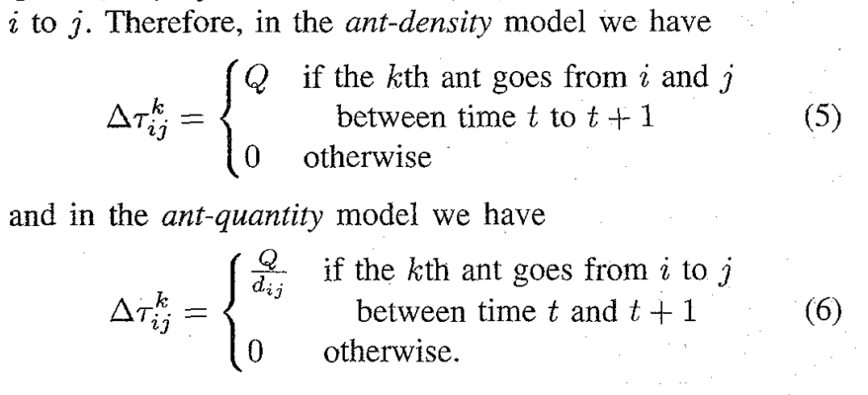
Parameter Setting and Basic Properties
α: priority for trail
{0, 0.5, 1, 2, 5}
β: priority for visibility
{0, 1, 2, 5}
ρ: trail evaporation, range [0, 1]
{0.3, 0.5, 0.7, 0.9, 0.999}
Q: trail amount, constant
{1, 100, 10000}
Ant-Cycle (Dorigo, M., et. al., 1996)
Ant-Density (Dorigo, M., et. al., 1996)
Ant-Quantity (Dorigo, M., et. al., 1996)
Notes:
Describe hyper parameters
Describe ant-cycle, ant-density, ant-quantity

Slide 25
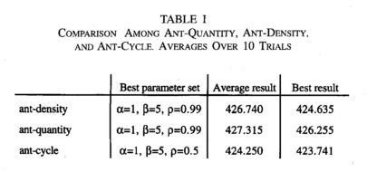
Parameter Setting and Basic Properties
α: priority for trail
{0, 0.5, 1, 2, 5}
β: priority for visibility
{0, 1, 2, 5]
ρ: trail evaporation, range [0, 1]
{0.3, 0.5, 0.7, 0.9, 0.999}
Q: trail amount, constant
{1, 100, 10000}
(Dorigo, M., et. al., 1996)

Slide 26
Parameter Setting and Basic Properties
α: priority for trail
{0, 0.5, 1, 2, 5}
β: priority for visibility
{0, 1, 2, 5]
ρ: trail evaporation, range [0, 1]
{0.3, 0.5, 0.7, 0.9, 0.999}
Q: trail amount, constant
{1, 100, 10000}
(Dorigo, M., et. al., 1996)

Slide 27
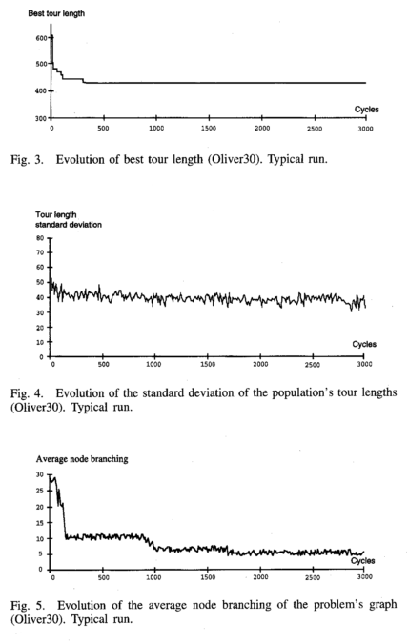
Parameter Setting and Basic Properties
(Dorigo, M., et. al., 1996)

Slide 28
Parameter Setting and Basic Properties
(Dorigo, M., et. al., 1996)

Slide 29
Parameter Setting and Basic Properties
(Dorigo, M., et. al., 1996)

Slide 30
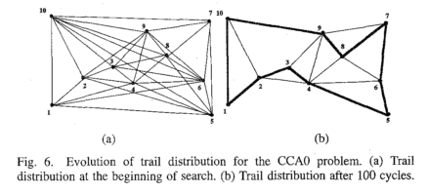
Parameter Setting and Basic Properties
(Dorigo, M., et. al., 1996)

Slide 31
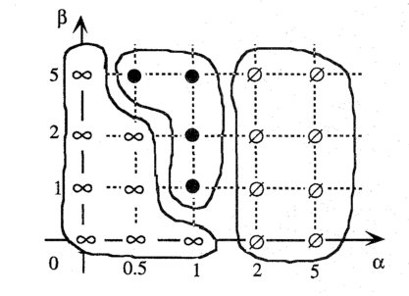
Parameter Setting and Basic Properties
(Dorigo, M., et. al., 1996)

Slide 32
Extensions and Advanced Properties
Synergistic effects
Best results when # agents = # nodes
Initialization
Uniform distribution better than all ants starting on same node
Elitist strategy
Trail for best tour = e * Q/L
Set e to happy medium
Increasing the problem dimensions
O(NC*n^3): 16 city TSP (8 seconds), 64 city TSP (97k seconds)

Slide 33
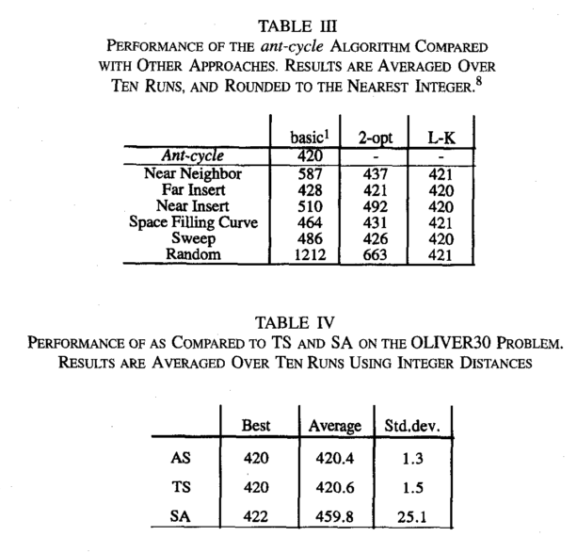
Comparison with Other Heuristics
(Dorigo, M., et. al., 1996)
(Dorigo, M., et. al., 1996)

Slide 34
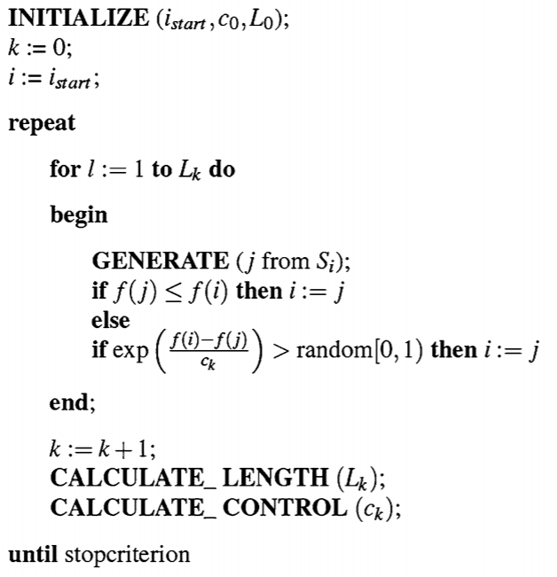
Comparison with Other Heuristics
Simulated Annealing (SA)
c – allowance for worse solutions
L – how long to use current c
(Aarts, E., Korst, J., & Michiels, W., 2014)

Slide 35
Comparison with Other Heuristics
Simulated Annealing (SA)
c – allowance for worse solutions
L – how long to use current c
(Aarts, E., Korst, J., & Michiels, W., 2014)

Slide 36
Comparison with Other Heuristics
Simulated Annealing (SA)
c – allowance for worse solutions
L – how long to use current c
(Aarts, E., Korst, J., & Michiels, W., 2014)

Slide 37
Comparison with Other Heuristics
Simulated Annealing (SA)
c – allowance for worse solutions
L – how long to use current c
(Aarts, E., Korst, J., & Michiels, W., 2014)

Slide 38
Comparison with Other Heuristics
Simulated Annealing (SA)
c – allowance for worse solutions
L – how long to use current c
(Aarts, E., Korst, J., & Michiels, W., 2014)

Slide 39
Comparison with Other Heuristics
Simulated Annealing (SA)
c – allowance for worse solutions
L – how long to use current c
(Aarts, E., Korst, J., & Michiels, W., 2014)

Slide 40
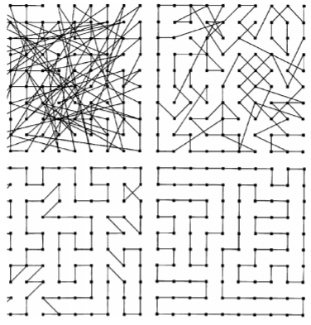
Comparison with Other Heuristics
Simulated Annealing (SA)
c – allowance for worse solutions
L – how long to use current c
(Aarts, E., Korst, J., & Michiels, W., 2014)

Slide 41
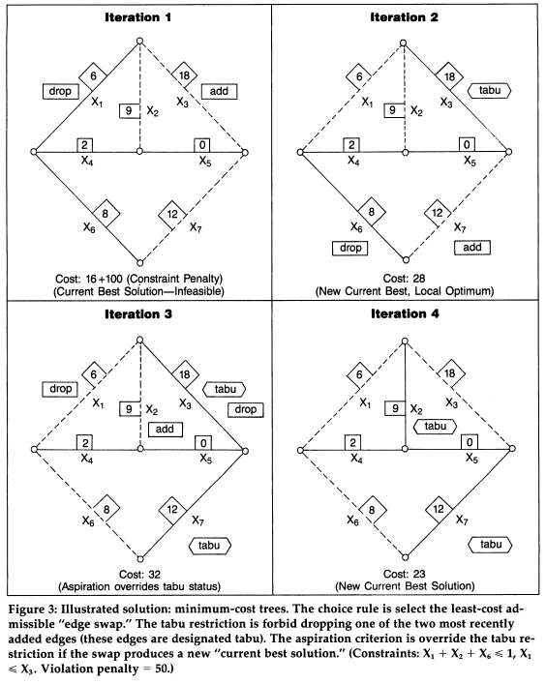
Comparison with Other Heuristics
Simulated Annealing (SA)
c – allowance for worse solutions
L – how long to use current c
Tabu Search (TS)
Explores beyond local optimum
Memory structures
Example:
Only include X1 if X3 is included
Include at most one from {X1, X2, X6}
(Glover, F., 1990)

Slide 42
Comparison with Other Heuristics
Simulated Annealing (SA)
c – allowance for worse solutions
L – how long to use current c
Tabu Search (TS)
Explores beyond local optimum
Memory structures
Example:
Only include X1 if X3 is included
Include at most one from {X1, X2, X6}
(Glover, F., 1990)

Slide 43
Comparison with Other Heuristics
Simulated Annealing (SA)
c – allowance for worse solutions
L – how long to use current c
Tabu Search (TS)
Explores beyond local optimum
Memory structures
Example:
Only include X1 if X3 is included
Include at most one from {X1, X2, X6}
(Glover, F., 1990)

Slide 44
Comparison with Other Heuristics
Simulated Annealing (SA)
c – allowance for worse solutions
L – how long to use current c
Tabu Search (TS)
Explores beyond local optimum
Memory structures
Example:
Only include X1 if X3 is included
Include at most one from {X1, X2, X6}
(Glover, F., 1990)

Slide 45
Generality of the Approach
Assymetric Traveling Salesman Problem (ATSP)
AS got within 3.3% of optimum on RY48P
Quadratic Assignment Problem (QAP)

Slide 46
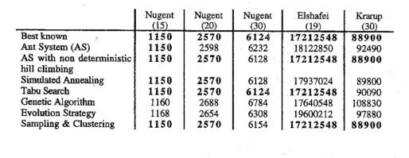
Generality of Approach
(Dorigo, M., et. al., 1996)

Slide 47
Generality of Approach
(Dorigo, M., et. al., 1996)

Slide 48
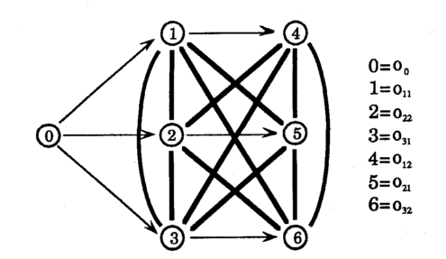
Generality of the Approach
Assymetric Traveling Salesman Problem (ATSP)
AS got within 3.3% of optimum on RY48P
Quadratic Assignment Problem (QAP)
Job Scheduling Problem (JSP)
Job-machine combos : 10x10, 10x15
AS got within 10% of optimum
(Dorigo, M., et. al., 1996)

Slide 49
Discussion of AS Characteristics
Early search heuristic, build-up experience
Adding trail is like shortening path distance
Trail combines good parts of all ants’ searches
Contributions:
1. Positive feedback tool
2. Demonstration of synergy
3. Demonstration AS generality
4. New “natural” algorithm

Slide 50
Strength 1 – Analysis of Stagnation
Diversity through standard deviations / node branching
Convergence with alpha/beta effects
1) Diversity lessens likelihood of local optimum
2) Local + Global = Optimal

Slide 51
Strength 1 – Analysis of Stagnation
(Dorigo, M., et. al., 1996)

Slide 52
Strength 1 – Analysis of Stagnation
(Dorigo, M., et. al., 1996)

Slide 53
Strength 1 – Analysis of Stagnation
(Dorigo, M., et. al., 1996)

Slide 54
Strength 1 – Analysis of Stagnation
(Dorigo, M., et. al., 1996)

Slide 55
Strength 2 – Trail Update Experiments
Analyzed performance of ant-cycle, ant-quantity, ant-density.
Chose option with evaluation of entire tour
Similar to genetic algorithms “generations”
Reinforces global information
Investigates effect of different feedbacks

Slide 56
Strength 3 – Discussion of Generality
Discussed AS versatility– ATSP
Discussed AS robustness – QAP, JSP
1) Justifies consideration for AS in other applications
2) Showcases core AS mechanisms
Graph representation
Positive Feedback
Early search heuristic
Constraints (tabu lists)

Slide 57
Weakness 1 – What is “good enough?”
“quick convergence to satisfactory solutions” (page 35, Dorigo et. al., 1996)
“converged quickly to satisfactory solutions” (page 37, Dorigo et. al., 1996)
1) “satisfactory solutions” is arbitrary, domain-dependent
2) Lacks discussion of tradeoff between efficiency/accuracy for high precision scenarios

Slide 58
Weakness 2 – Chance versus Flaw
Authors don’t discuss reasons behind AS limitations
Differences b/w stochastic effects, parameter effects, and algorithm effects
Lacks discussion of corner cases
1) Tricky problem aspects for AS remain unknown
2) Areas for algorithm improvement remain unknown
Notes:
They do discuss synergy, initialization, elitism, and problem dimensions

Slide 59
Weakness 3 – Population Size Discussion
Found linear relationship between problem size and ant population size.
Lacks support for this claim.
a) Only analyzed relationship to node count
b) Should have explored branching factor, edge variance
c) 16-cities problem found optimum with 8-16 ants
1) If true m* is lower, results might be better.
2) If true m* is higher, then AS might not scale up.

Slide 60
Extension 1 – Dynamic Environments
Adapt AS to adapt to dynamic environments
1) How can AS react to contradictions to path trail assumptions?
2) How can local and global experience synergize to new environments?
3) How does a population process stimuli for new searches?
Adapted from (Dorigo, M., et. al., 1996)
Notes:
Perhaps temporarily adjusting alpha/beta parameters

Slide 61
Extension 2 – Encourage Exploration
Exploration versus Exploitation
Late search exploration
Gradually decrease α or increase β
Vary ρ with node branching factor
Ant subspecies (i.e. Ant-cycle + Ant-density)
1) What is the relative importance of trail/visibility over time?
2) How does varied search diversity affect optimization?
Notes:
To make convergence faster: 1) do only half a tour, 2) combine solutions from two ants

Slide 62
References
Aarts, E., Korst, J., & Michiels, W. (2014). Search Methodologies. In E. K. Burke & G. Kendall (Eds.), Search Methodologies (Second, pp. 265–285). Springer.
Dorigo, M., Maniezzo, V., & Colorni, A. (1996). Ant System: Optimization by a Colony of Cooperating Agents. IEEE Transactions on Systems, Man, and Cybernetics - Part B, 26(1), 29–41.
Glover, F. (1990). Tabu Search: A Tutorial. Interfaces, 20(4), 74–94.

